Slide 1
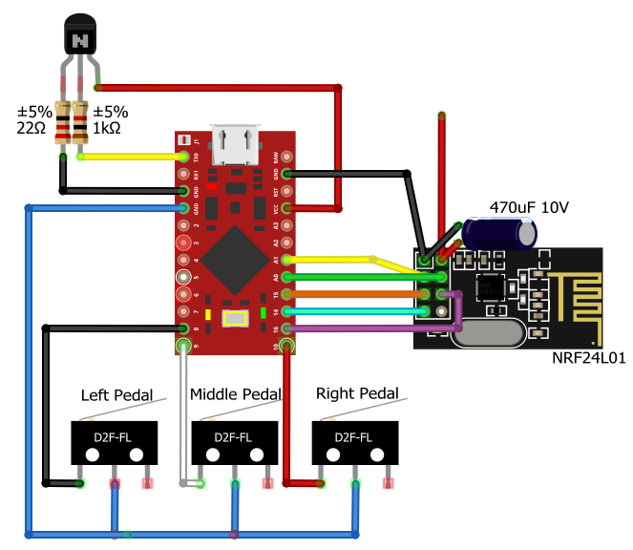
+3.3V Source
Enable power supply
keep-alive circuit
CE Pin
CS Pin
SCK Pin
MISO Pin
MOSI Pin

Slide 2
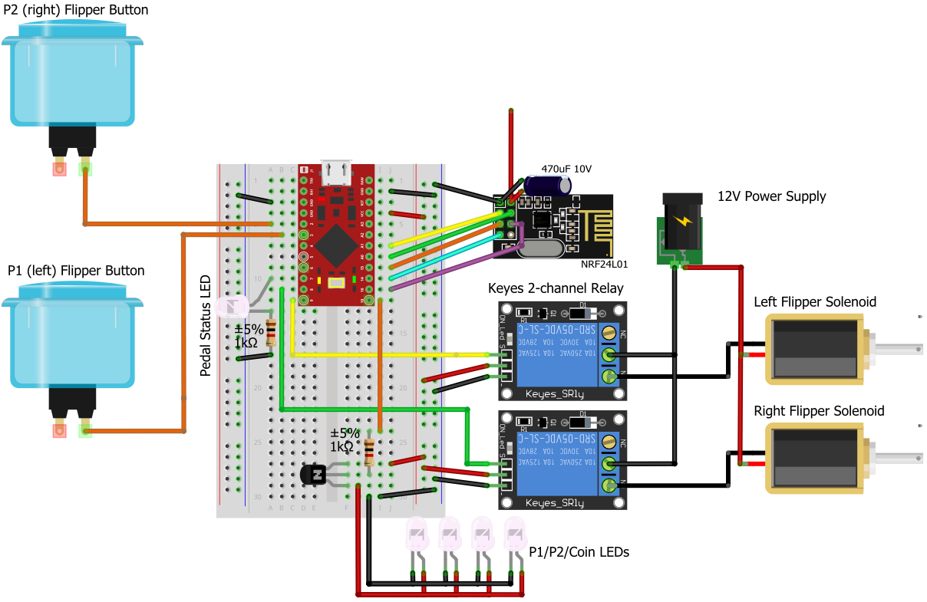
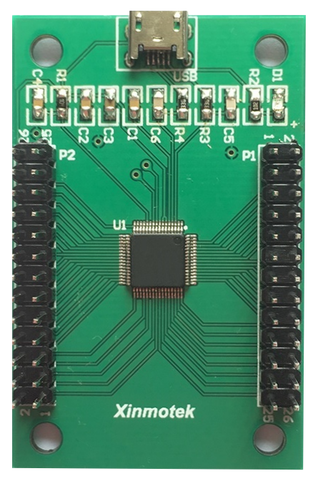
+3.3V Source
CE Pin
CS Pin
SCK Pin
MISO Pin
MOSI Pin

